Slide 1
Generic Kubernetes based load testing framework
Group 5 Client: Rapid7
2nd YEARS
Holly Daly - 20331814
Declan Quinn - 20334565
Miguel Arrieta - 20332427
Abdelaziz Abushark - 20332134
3nd YEARS
Aaron Byrne - 19334098
Tomasz Bogun - 19335070
Vitali Borsak - 19335086

Slide 2

Overview
Create a mock search engine that searches vast amounts of data for specific information they need.
The proposed system will run performance tests on the piece of software and report back the results.
The test runner and project under test must be packaged up to a docker container and deployed to a Kubernetes cluster.
Monitor and graph the performance of the system.

Slide 3
The team and roles
Project under test:
Tomasz Bogun - 3rd Year
Declan Quinn - 2nd Year
Docker and Kubernetes:
Aaron Byrne - 3rd Year
Abdelaziz Abushark- 2nd Year
Test Runner and Configuration:
Vitali Borsak - 3rd Year
Holly Daly - 2nd Year
Miguel Arrieta - 2nd Year

Slide 4
Requirements
Functional
Performance testing system with a command line interface
Should test time, CPU, memory, disk and network utilization.
Keep track of these performance measurements through different software versions
Provides tests in isolation, through the use of a separate Kubernetes cluster.
Non- Functional
The end result should make it easy for our client to test their desired software
Project under test needs to perform well as it searches through terabytes of data.
Kubernetes must be easily scalable to test the clients project

Slide 5
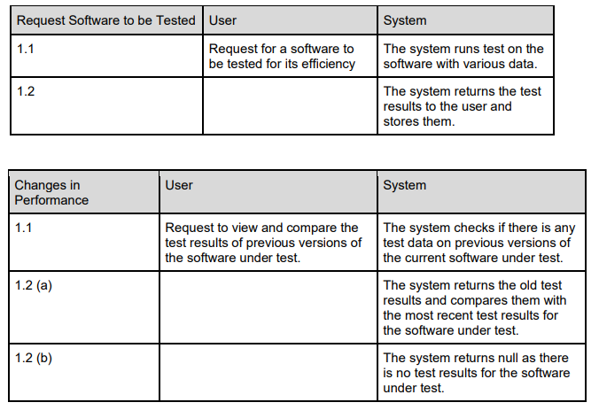
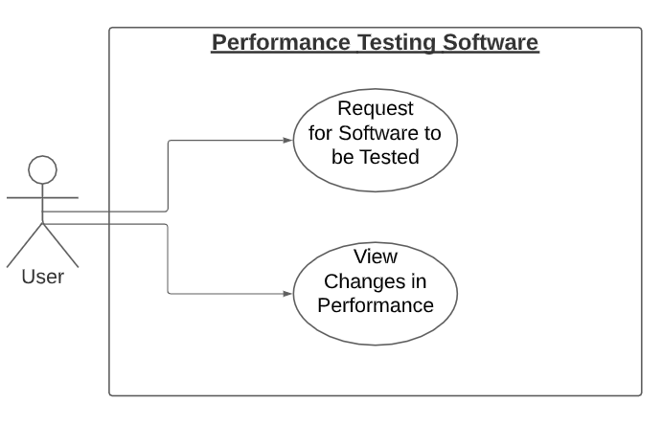
System Models - Use Case

Slide 6
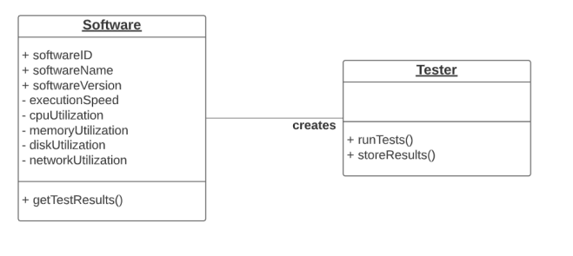
Object Model

Slide 7
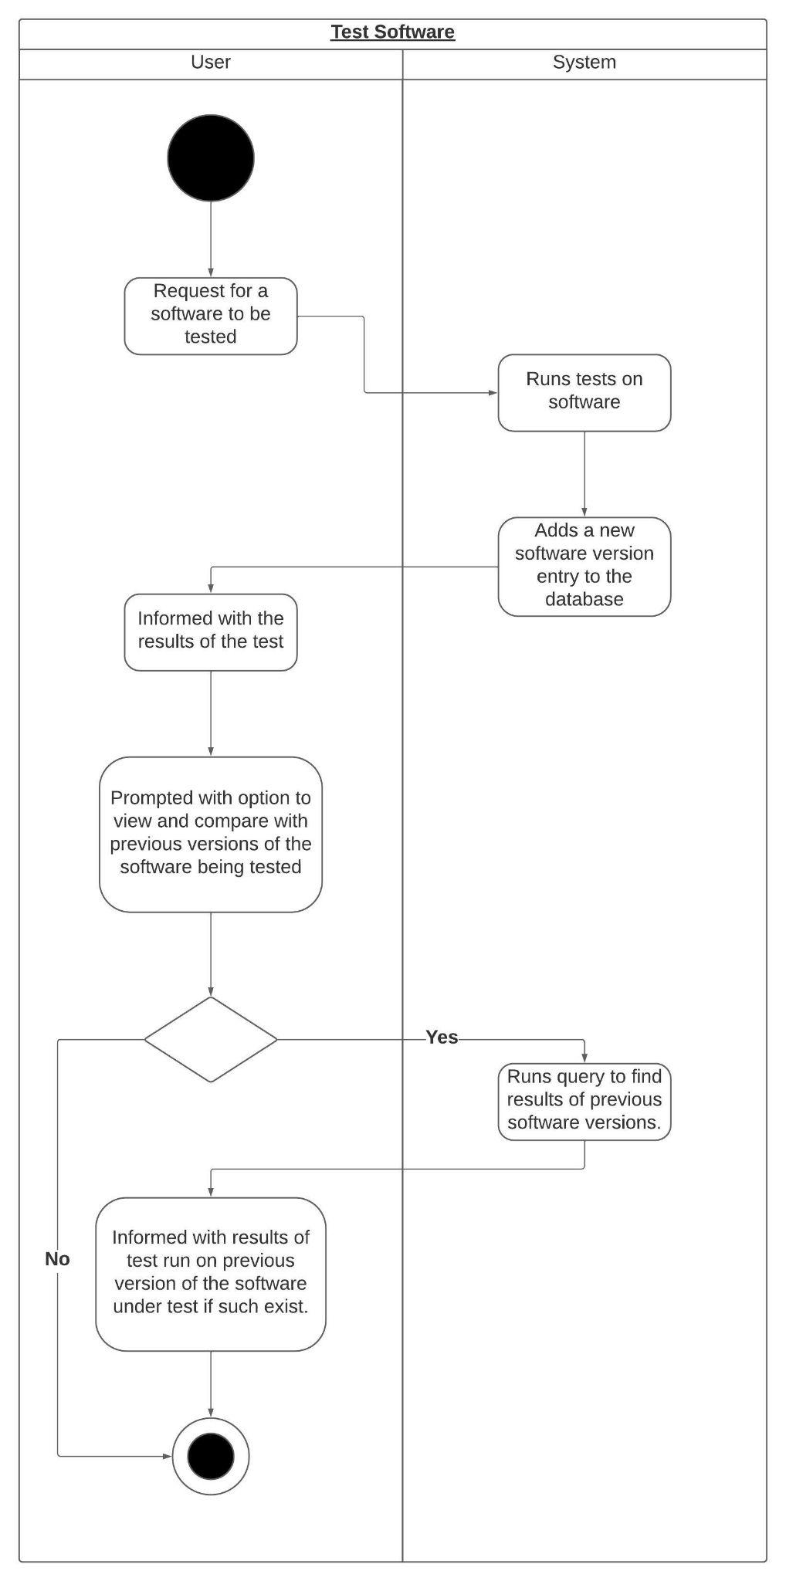
Dynamic Model

Slide 8
Questions?

